Slide 1
İNÖNÜ UNIVERSITY
DEPARTMENT OF
INTERNATIONAL RELATIONS
INTERNATIONAL RELATIONS
ASSOC.PROF.DR. FİKRET BİRDİŞLİ

Slide 2
RULES
1. Be prepare and ready to learn
2. Take care for timetable
3. No cellular phone and talking in class
4. Listen and participate to lesson
5. Take a note for remembering
6. You can drink
7. You can discuss with class via supervising professor
8. Ask and say anything about course
9. If you need you can out by permission

Slide 3
ABOUT DISCIPLINE
«International relations» is a term which refers to the relations between states.
«International Relations» is a term which refers to an academic discipline.

Slide 4
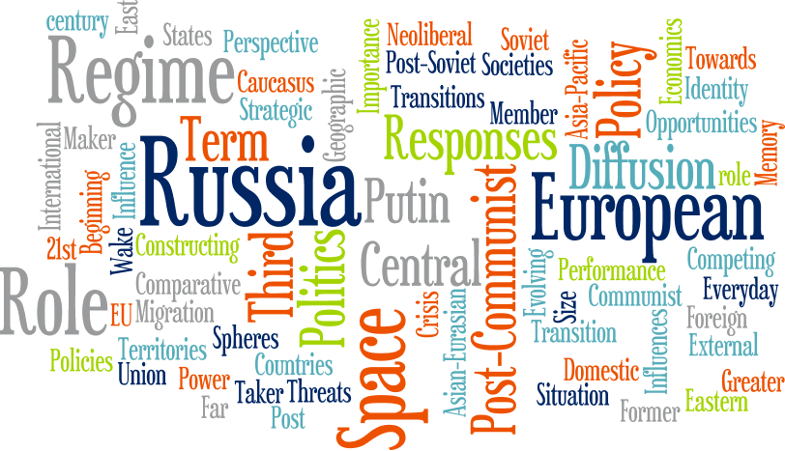
Main Glossary of The Field (Elementary)
World, Globe: Dünya
State: Devlet (organize siyasal topluluk)
Country: Ülke (toprak+halk+yönetim)
Territory: Ülke (toprak)
Republic: Cumhuriyet
Nation: Ulus
Power: İktidar
Goverment: Hükümet
Parliment: Meclis
President: Başkan
Secratery of State: Başkan yardımcısı, dış işleri bakanı
Foreign Affair/Ministry of Foreign Affairs: Dış İşleri/Dış İşleri Bakanlığı
Minister, Secretary of State : Bakan

Slide 5
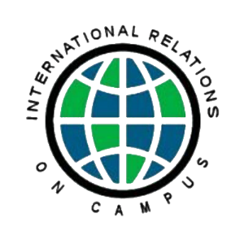
Prime minister, chancellor: Başbakan
Member of Parliment, Congressmen: Milletvekili
Policy, Politic, Political: Politika, politik/siyasi, Siyasal
Actors: Aktörler
Public: Halk, Kamuoyu, kamu
International Organisations: Uluslararası Kuruluşlar
International System: Uluslararası Sistem
Bipolar system
Multipolar system
International field: Uluslararası Alan
International laws: Uluslararası Hukuk
Alliance/ allied, ally: İttifak/ müttefik
Anarchy: Herhangi bir otoritenin olmadığı durum
Dominance: Baskın/üstün güç, egemen
Hegemony: Egemen, üstün güç
Sovereignty: Egemenlik

Slide 6
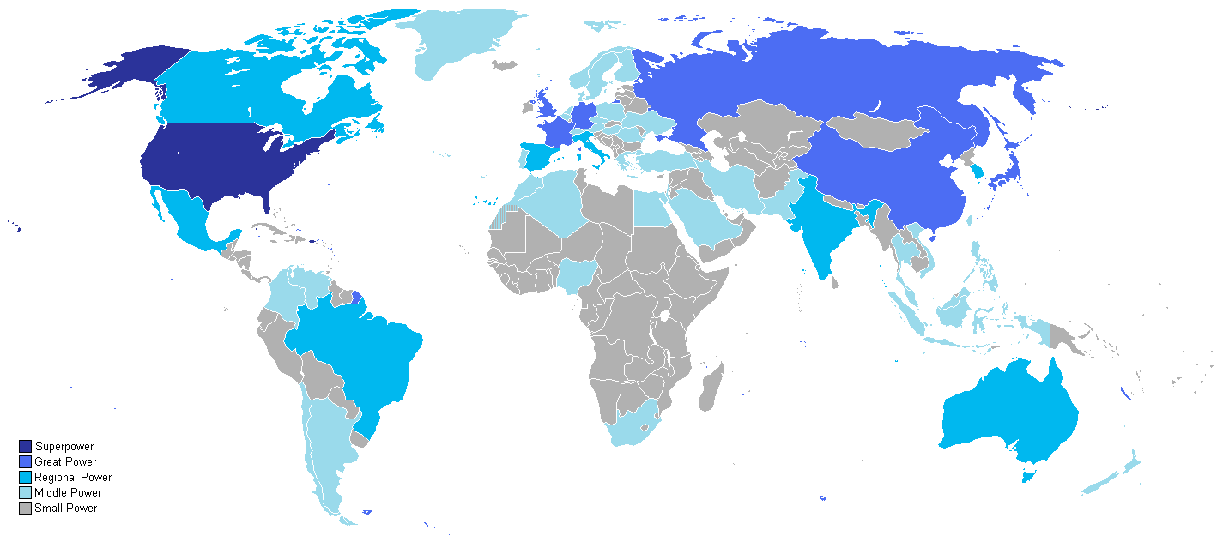
Economy, economic: Ekonomi (isim), ekonomik (sıfat)
Development: Gelişme, kalkınma
Growing, growth: Büyüme
War: savaş
Cold War: Soğuk Savaş
Second World War: İkinci Dünya Savaşı
Great War: Birinci Dünya Savaşı
Conflict: Çatışma
Crisis: Kriz
Military: Askeri, Askeriye
Soldier: Asker
Security: Güvenlik

Slide 7
Charter: Sözleşme
Agreement: Anlaşma
Treaty: Antlaşma
Deputy: Delege
Diplomacy, Diplomatic, Diplomat: Diplomasi (meslek ismi), Diplomatik (sıfat), Diplomat (diplomasi mesleğinde yer alan)
Ambassador: Büyükelçi
Consul: Konsolos
Honorary Consul: Fahri Konsolos
Europa, Asia, Africa, America, Antarctica:
Atlantic, pasific, Blac Sea, Mediterranean
Geopolitic: Jeopolitik
Global: Küresel
Great Powers: Büyük güçler
Identity: Kimlik

Slide 8
Jobs Opportunity in IR
Job in Goverment: Diplomacy and civil servant
Job in NGO’s: Think Tanks, NGO’s, Chambers
Job in privite sector: Banks, Export/Import companies, other privete entrepreneurship

Slide 9
Job in Government/ Diplomacy
Ministry of Foreign Policy
Intergovermental Organisations: UN, NATO,EU…….
Both governments and intergovernmental organizations (IGOs) play key roles in international relations and employ millions of people with interests and training in IR.
Despite differences between careers in IGOs and governments, there are numerous similarities. Both are hierarchical organizations, with competitive and highly regulated working environments.
You entrance into and promotion in these organizations is regulated by exams, performance evaluations, and tenure with the organization.
Finally, jobs in governments or IGOs may involve travel or living abroad, which many enjoy. However, promotion can be slow and frustrating. Usually, only individuals with advanced degrees or technical specializations achieve non–entry level positions.

Slide 10
Job in Government /Expertise (civil servant)
Ministries
Governmental Presidencies
Universities
There are sixteen ministry and many governmental presidencies in Turkey. They are employed International Relations program graduates.
For example, Presidency for Turks Abroad and Related Communities, Türksoy, National Agency, Yunus Emre Institute
Expert in Universities International Offices

Slide 11
Job in NGO’s
Think Tanks,
NGO’s, Foundations
Chambers
Nearly 30,000 NGOs exist, and that number grows daily. Thousands of individuals are interested in working in these organizations. Although all NGOs are different, many perform multiple functions: working in developing countries regarding a variety of issues; public outreach at home and abroad; lobbying governments to change their policies; designing projects to solve problems and attempting to find funding for their implementation.
Working for an NGO has many benefits. Workers often find themselves surrounded by others concerned about the same issues: improving the environment, protecting human rights, advancing economic development, or promoting better health care. The spirit of camaraderie can be exhilarating and rewarding.
While working for an NGO can be extremely rewarding personally, it is rarely rewarding financially. Most NGOs are nonprofit operations that pay workers meagerly for long hours. Moreover, many smaller NGOs engage in a constant fight for funding from governments, think tanks, private ffoundations, or individuals. The process of fundraising can be quite time consumingerie can be exhilarating and rewarding.

Slide 12
Despite the large number of NGOs, relatively low pay, and long hours, finding a job with an NGO can be difficult. One key is to be specific. Try to narrow down your interests in terms of substantive areas (e.g., human rights, environment) and/or geographic region.
Also think about whether you want to work in your own country or abroad. Positions abroad may be more rewarding but are in lower supply and higher demand Often, NGOs ask potential employees to volunteer for a period while they train, before being hired. Increasingly, some companies place workers in an NGO or volunteer opportunity for a price. By paying to work, you can gain a probationary period to develop your skills and familiarize yourself with the operation so as to become efficient before going on the payroll.
in Turkey number of Think Tank are around 20-50, but in the World there are plenty of think thank which employ thousands people with huge budgets in Turkey there ara thousands of NGO’s and Foundations such as ÇEKÜL, TEMA, LÖSEV, TEV and
Amnesty International, UNESCO, Greenpeace, Habitat, UNİCEF etc.

Slide 13
Job in Privite Sector
International business
Banks,
Export/Import companies,
Other privite entrepreneurship
As the pace and scope of globalization have accelerated, opportunities to work in
international business have blossomed. For many large companies, the domestic/global distinction has ceased to exist. This new context provides opportunities and challenges for potential em
Careers in international business offer many advantages.
Business jobs can pay substantially more than those in governments or NGOs and can open opportunities to travel extensively and network globally.
Foreign-based jobs mean relocation to another country to work and immerse oneself in another culture eployees.
International opportunities arise in many business sectors. Banking, marketing (public relations), sales, and computing/telecommunications have seen tremendous growth in recent years. These jobs fall into three broad categories: (1) those located domestically, yet involving significant interactions with fi rms abroad; (2) domestic jobs working for foreign-based companies; and (3) those based abroad, for foreign or domestic firms.

Slide 14
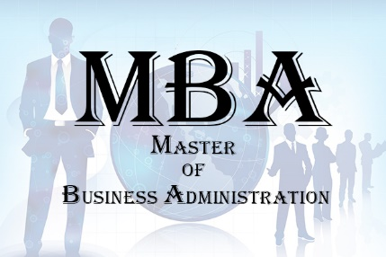
One key to landing in the international business world is to develop two families of skills: those related to international relations and those related to business operations.
Traditional MBA (Masters in Business Administration) and business school programs will be helpful for all three types of jobs, yet for jobs based abroad, employers often also look for a broader set of skills taught in economics, political science, and communications.
Thus, not only traditional business skills, but language and cultural skills, are essential. Employers look for those who have knowledge of a country’s human and economic geography as well as culture.
Experience with study abroad, especially including working abroad, can help Show an ability to adapt and function well in other cultures. Strong analytical and especially writing abilities also matter greatly to employers.

Slide 15
Job in Education and Academic Life
Lecturer in English
Researcher
Postgraduate degree
Master
Doctorate
Faculty member
Assistant Professor
Associate Professor
Professor

Slide 16
People follow various paths to an interest in teaching and researching in the field of international relations.
Your own professor or instructor is likely to have a unique story about how he or she became interested in international affairs.
One advantage of an academic and research career, whether at a teaching-oriented institution or a large research university, is intellectual freedom.
One can spend a career approaching a variety of topics that are interesting and constantly evolving, that may involve travel abroad for fieldwork, and that may let you network with hundreds of colleagues interested in similar topics.
Most research positions (e.g., in think tanks) are different in two respects. First, these jobs often give more direction to an individual in terms of the research to be performed. Second, there is little or no teaching involved. Still, for those interested in IR research, such jobs can result in a wider dissemination of one’s work to a broader audience that often includes policy makers.

Slide 17
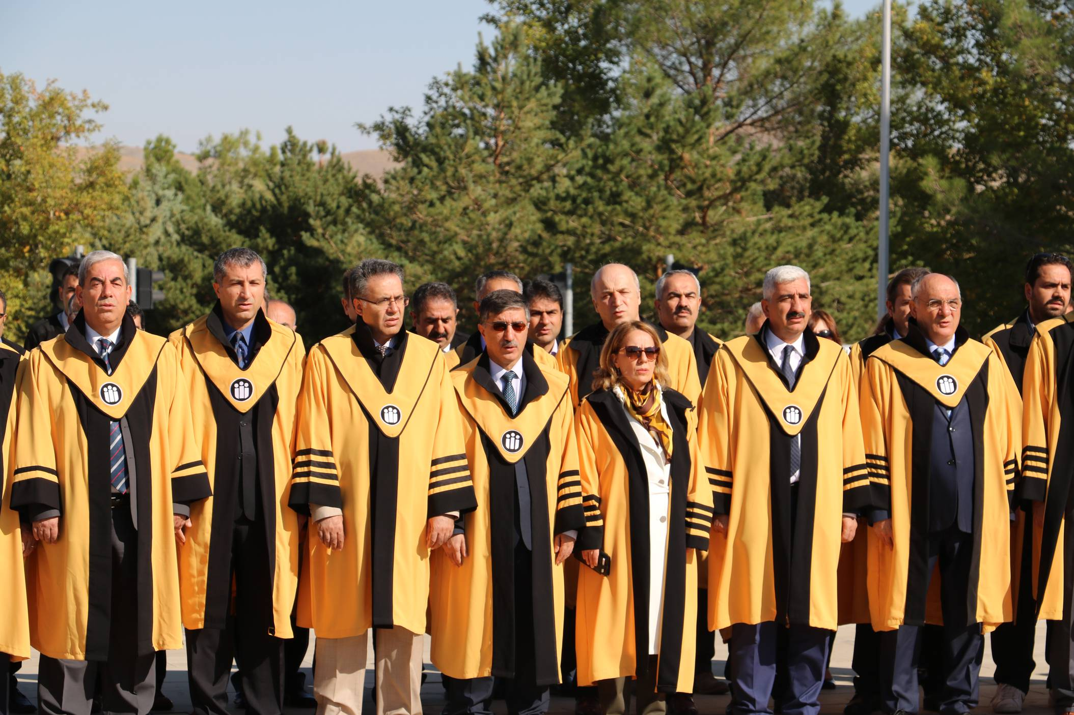
To teach IR at an advanced level or to perform research for think tanks and government agencies usually requires an advanced degree—nearly always a masters degree, often a doctorate (Ph.D.).
Masters degree programs often take between one and two years, while a Ph.D. in international relations usually takes a minimum of five years.
Often, students take time off between their undergraduate and graduate educations to travel internationally or get work experience to hone their interests. Of course, many students never return to extend their education if they fi nd a job that allows them to achieve their personal and career goals.

Slide 18
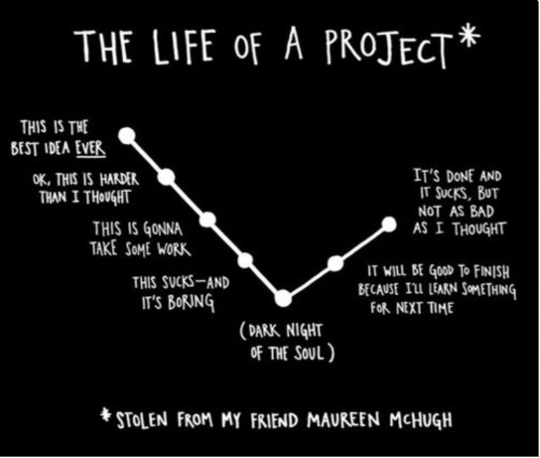
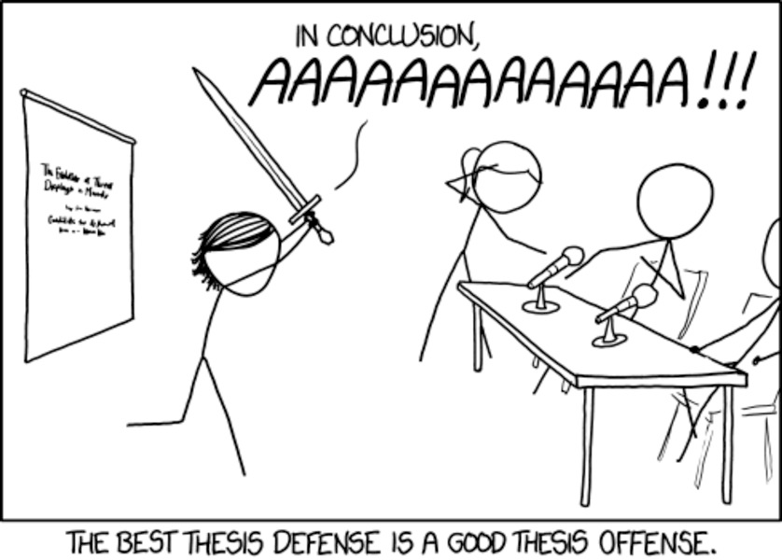
Whether one wants to pursue an advanced degree for the purposes of teaching in an academic setting or engaging in applied research, there are important skill sets to develop. First and foremost is critical thinking. Scholars and researchers must consider many alternatives as answers to questions, while being able to evaluate the validity or importance of those alternatives.
Second is writing. Before, during, and after producing a thesis, writing is a key skill for academics and researchers.
Finally, think about developing a set of applied skills to use as a toolbox while analyzing questions. The contents of this toolbox might include other languages to facilitate fieldwork abroad. It could include statistics and data skills to facilitate quantitative analysis. Or it could include mathematics to use game theoretic models. No matter which tools you emphasize, specialized skills will help you answer research questions, whether as part of the Academy or in a private or governmental research organization.

Slide 19
Introduction to the IR
We use………………while studying IR
Maps
Official documents: Constitutions, laws, declarations, agreement,
History: Memories, relics, diaries, historical remnants and every type of history such as humanity, art, war, national and economy history.
Economy: Macro and micro level
Sociology
Religions
Books and Academic Writings
Web
International Magazines
Newspapers
Broadcast
News Agencies

Slide 20
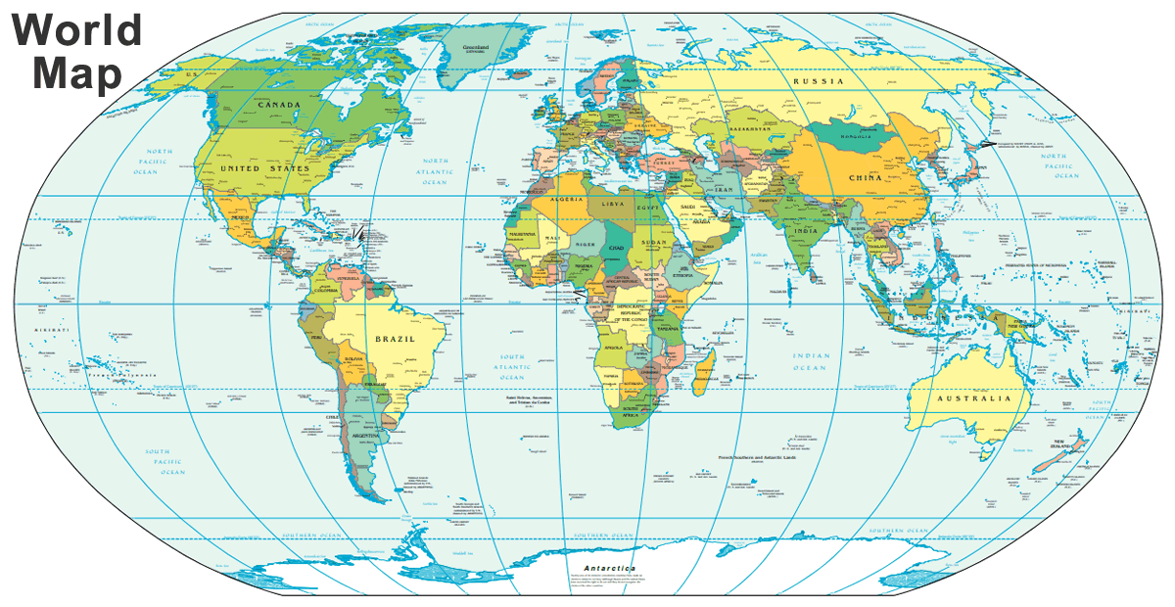

Slide 21
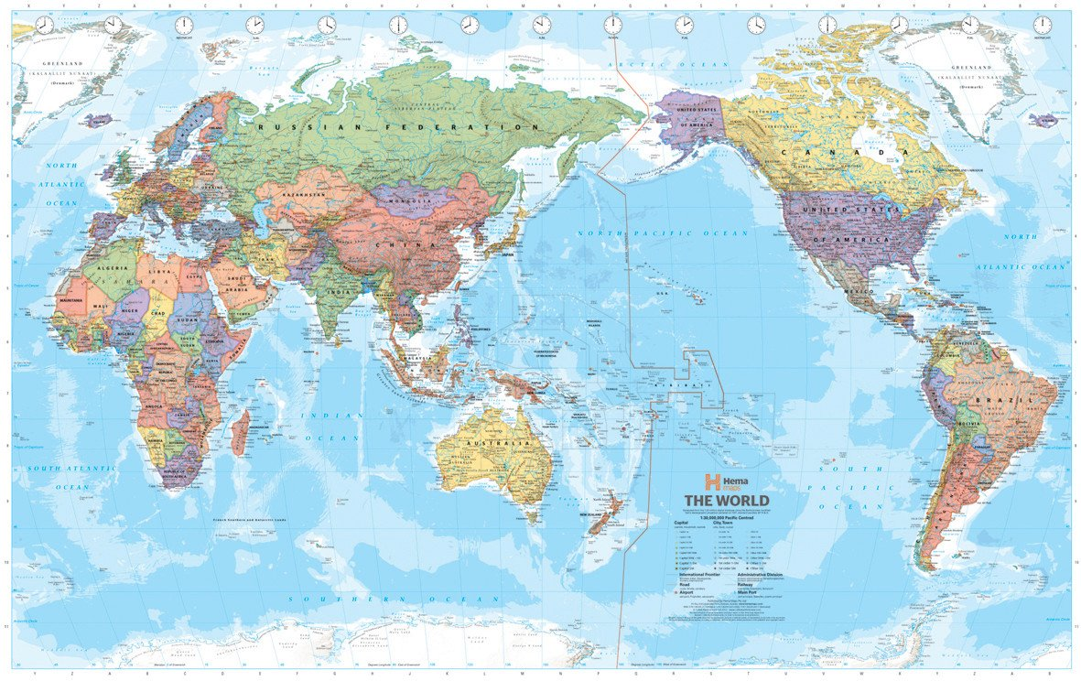

Slide 22
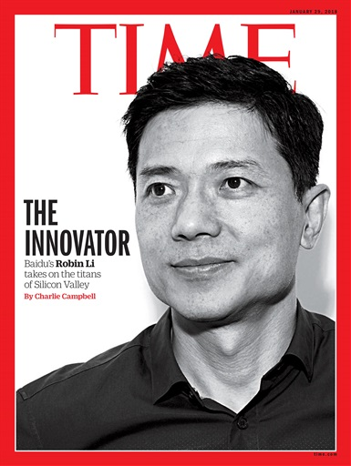
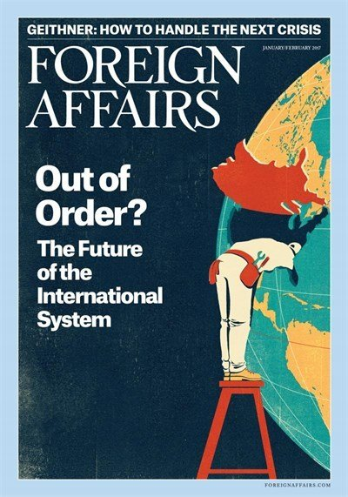
International Magazines
Foreign Policy
Foreign Affairs
Times
Newsweek

Slide 23
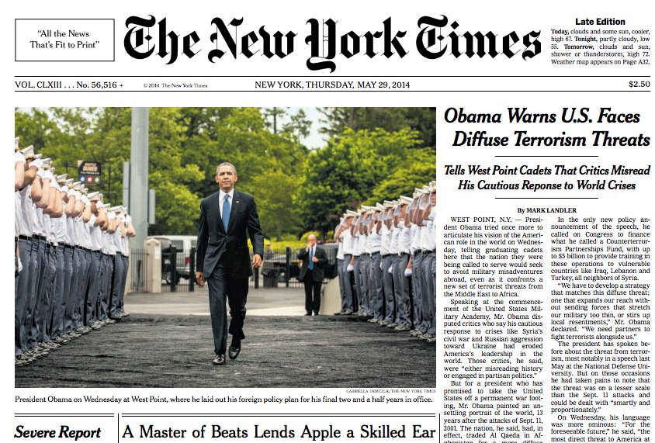
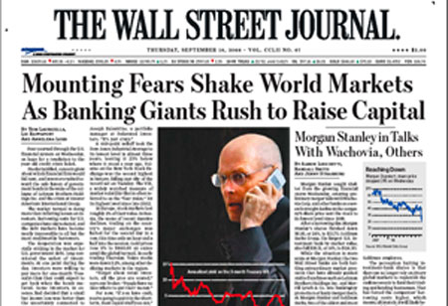
Newspaper
Financial Times
The New York Time
The Wall Street Journal
Russia Beyond

Slide 24
International Broadcast
BBC
CNN International
Al Cezira
VoA
Voice of Turkey, TRT
Deutsche Welle (DW)
France 24
Russia Today
Sky News

Slide 25
News Agency
Associated Press
Agence France-Presse
Fars News Agency
Anadolu Agency
Reuters
Interfax
Jiji Press

